Slide 1
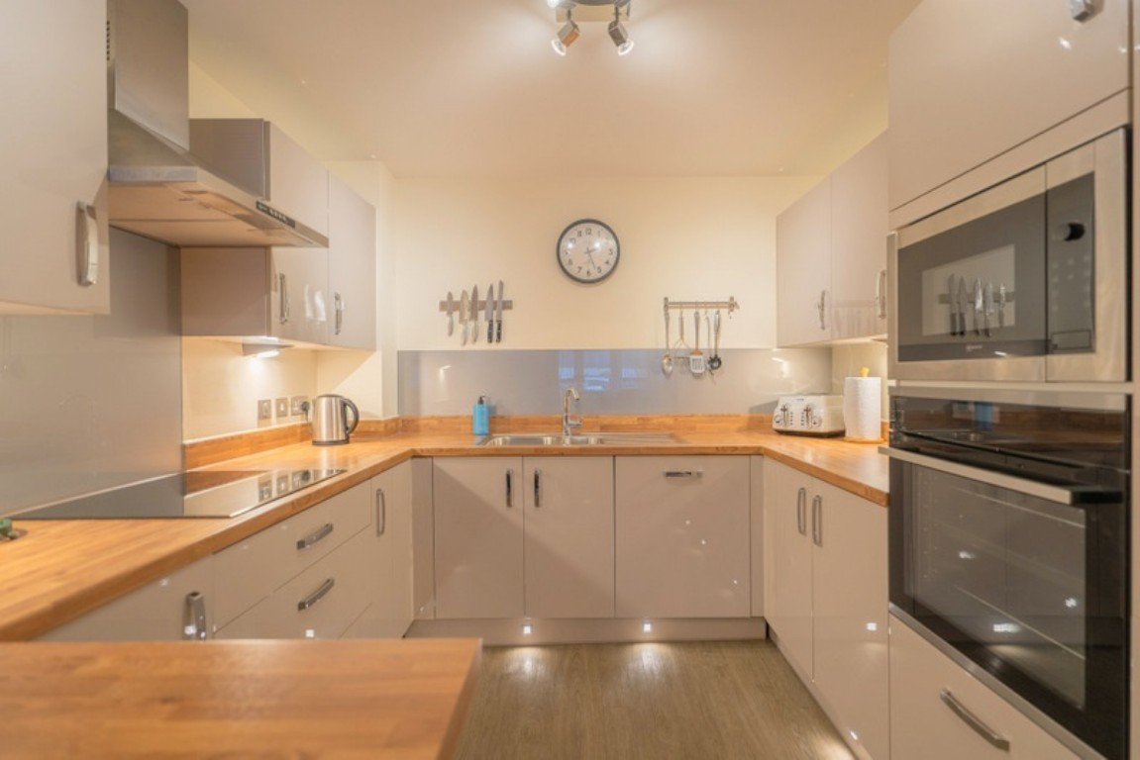
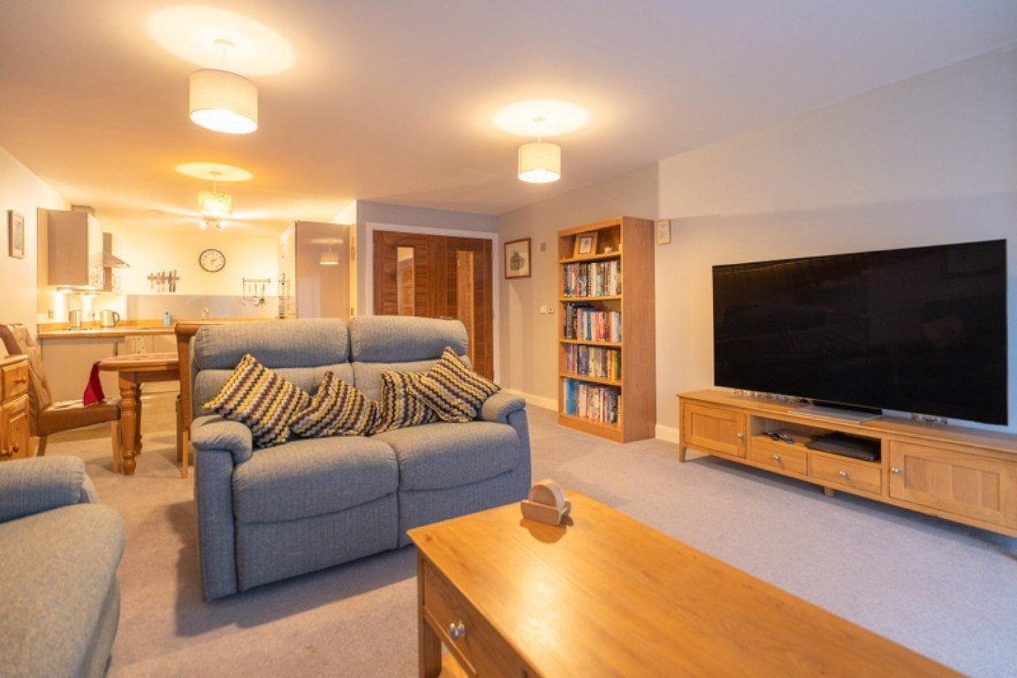
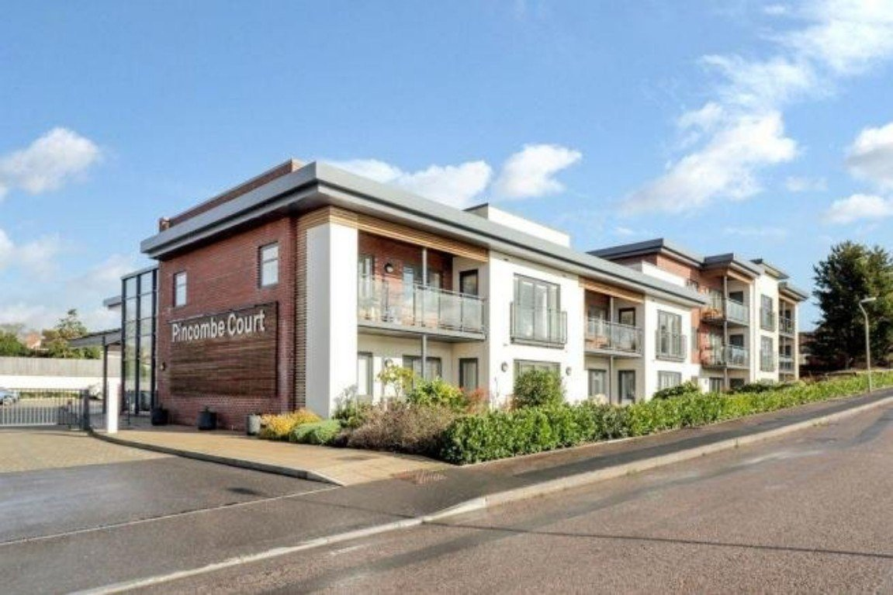
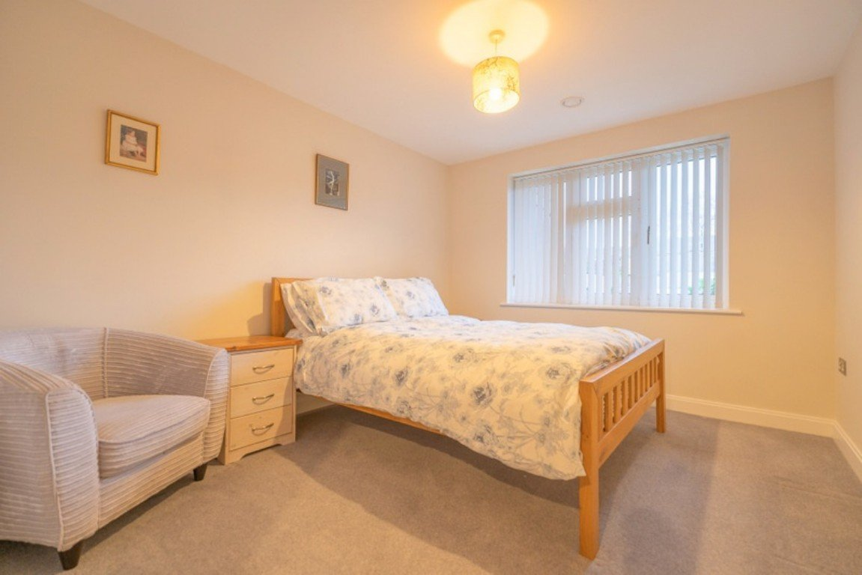
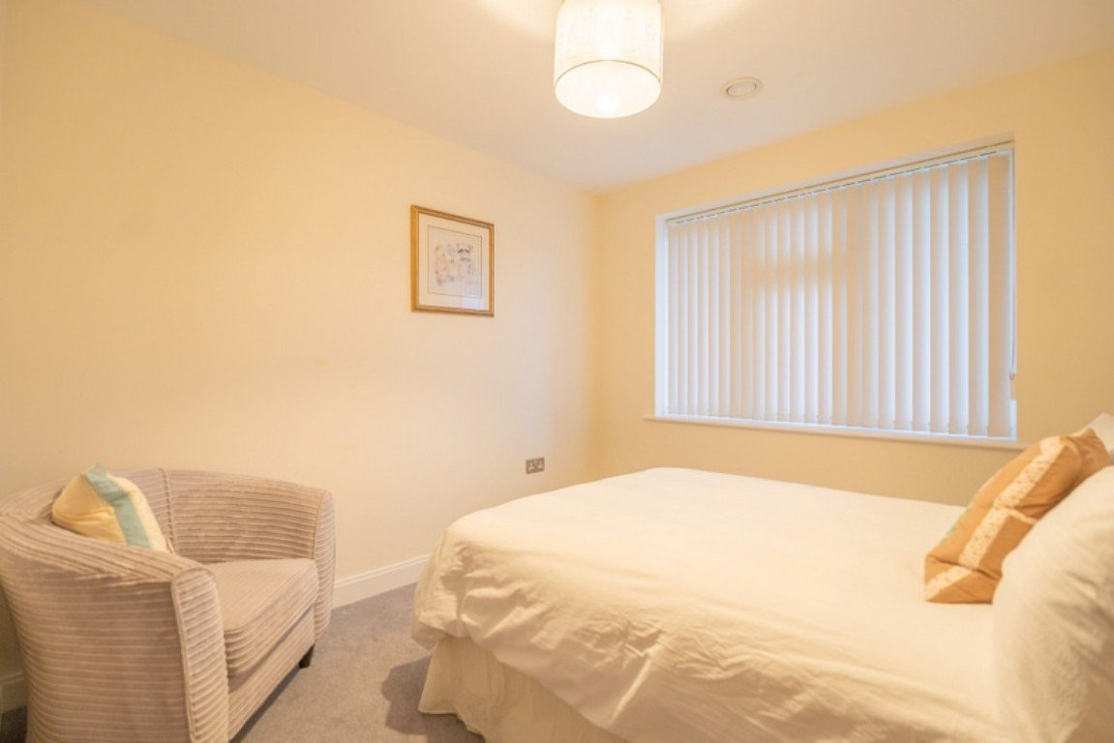
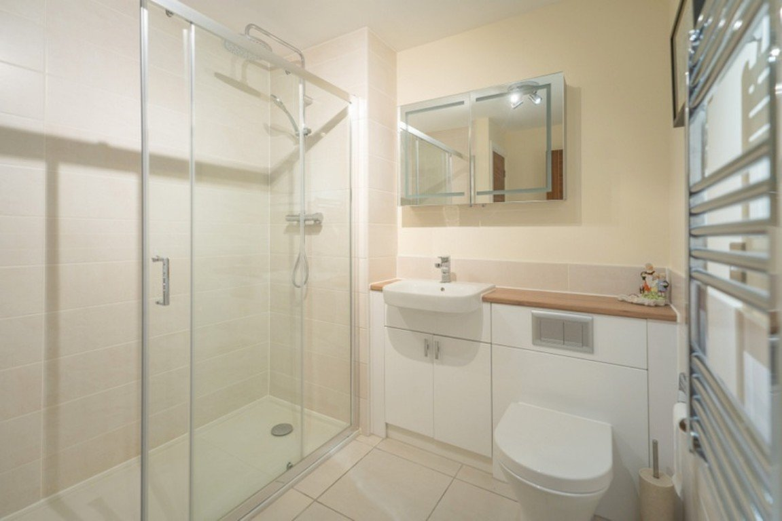
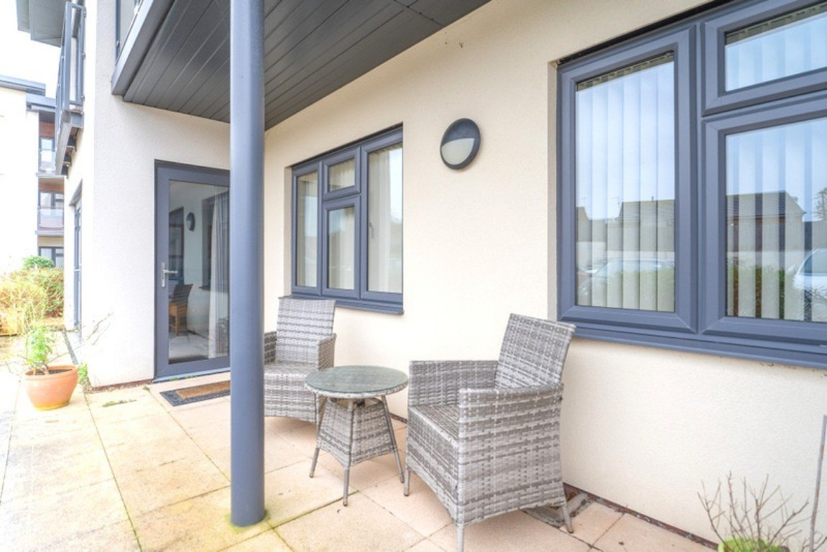
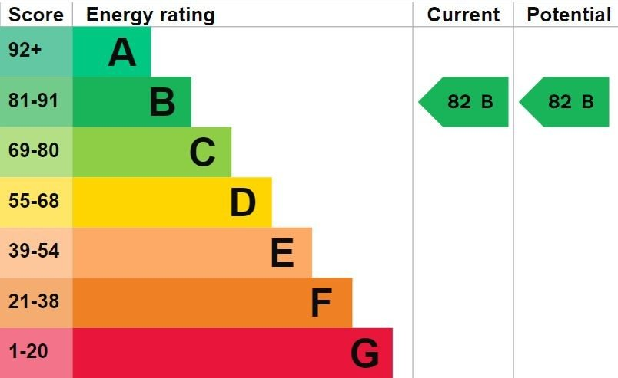
www.pennys.net
Apartment 1 Pincombe Court, Buckingham Close, Exmouth, EX8 2JB
PRICE £360,000
TENURE Leasehold
A McCarthy & Stone Built Lifestyle Two Bedroom Luxury Apartment Situated On The Ground Floor Of This Select Development With Impressive Communal Areas, Good Size Patio Sun Terrace, Well Tendered Communal Gardens And Secure Parking Space Enjoying A Convenient Location Close To A Range Of Amenities
Spacious Reception Hall • Lounge/Dining Room •
Well Equipped And Stylish Kitchen With Range Of Built-In Appliances •
Two Double Bedrooms - Main Bedroom With Walk-in Dressing Room & Stylish En-Suite Shower Room/WC • Second Bedroom With Walk-in Wardrobe •
Main Stylish Shower Room/WC • Under Floor Heating •
Double Glazed Windows • No Onward Chain •
Pennys Estate Agents Limited for themselves and for the vendor of this property whose agents they are give notice that:- (1) These particulars do not constitute any part of an offer or a contract. (2) All statements contained in these particulars are made without responsibility on the part of Pennys Estate Agents Limited. (3) None of the statements contained in these particulars are to be relied upon as a statement or representation of fact. (4) Any intending purchaser must satisfy himself/herself by inspection or otherwise as to the correctness of each of the statements contained in these particulars. (5) The vendor does not make or give and neither do Pennys Estate Agents Limited nor any person in their employment has any authority to make or give any representation or warranty whatever in relation to this property.
PENNYS ESTATE AGENTS
2 Rolle House, Rolle Street, Exmouth, Devon, EX8 2SN
Tel: 01395 264111 EMail: help@pennys.net

Slide 2
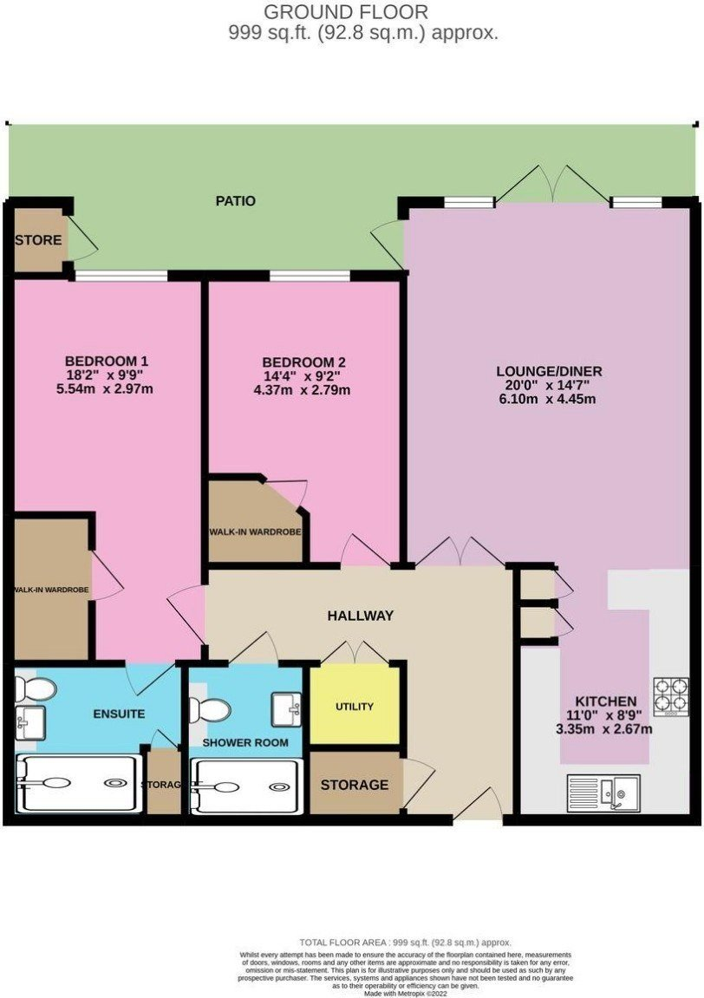
Apartment 1 Pincombe Court, Buckingham Close, Exmouth, EX8 2JB
An age-exclusive development of 30 spacious two bedroom apartments suitable for people over the age of 55, giving both the independence and lifestyle that most wish to maintain. 'Lifestyle Living' is designed so that you can spend less time looking after your property so you're free to spend more time living your life. Every 'Lifestyle Living' apartment is deliberately designed to be easy and cost effective to run. All routine maintenance to the building and grounds is taken care of with the costs covered by the annual service charge which includes window cleaning, gardening and the general upkeep of the outside of the building and communal areas and includes water rates, leaving you to enjoy a virtually maintenance free lifestyle doing the things you'd rather be doing.
THE DEVELOPMENT: Management Service paid for through your service charge to include buildings insurance, security lighting for the communal areas internally and externally, window cleaning, cleaning of communal areas, up keep of the gardens and water rates. 24 Hour Emergency Call System. Should you need assistance day or night.
THE ACCOMMODATION COMPRISES: Communal entrance with stairs and lift to all floors. Apartment 1 is located on the GROUND FLOOR and accessed via own private front door with spy hole and letter box leading to:
SPACIOUS RECEPTION HALL: Wall mounted remote control door entry system; thermostat control for under-floor heating; good size storage cupboard housing the electric consumer unit, electric meters and Dimplex water control system.
UTILITIES CUPBOARD: A cupboard housing Vent Axia ventilation system which provides air filtration into all rooms and space for washer dryer.
LOUNGE/DINING ROOM: 20' 0" x 14' 7" (6.1m x 4.44m) A most spacious room with double glazed double doors with picture windows to either side opening onto the patio sun terrace and further single patio door onto additional patio area; television/satellite/telephone point; under-floor heating; thermostat control for under-floor heating.
KITCHEN: 11' 0" x 8' 9" (3.35m x 2.67m) A high quality and well-equipped kitchen fitted with a range of wood effect work top surfaces with matching splashback and incorporating a small breakfast bar area; range of base cupboards, drawer units, integrated dishwasher beneath work tops; integrated fridge and freezer; pull-out larder style cupboard; inset induction hob with glass splashback and stainless steel chimney style extractor hood over with light; inset single drainer sink unit with mixer tap and additional glass splashback; built-in oven and microwave; ceiling spotlighting and plinth lighting; Vinyl wood effect flooring.
BEDROOM ONE: 18' 2" x 9' 9" (5.54m x 2.97m) A most spacious main bedroom with double glazed window to front aspect; impressive walk-in wardrobe with light, fitted shelving and clothes rail; under-floor heating and thermostat control for under-floor heating; television and telephone points.
EN-SUITE SHOWER ROOM/WC: A high quality luxuriously fitted suite comprising of a large ease of access shower cubicle with shower unit and sliding shower splash screen door; wash hand basin set in display surface with fitted cupboards beneath; WC with concealed cistern, push button flush and display surface over; wall mounted mirror-fronted medicine cabinet with built-in lighting; chrome heated towel rail; linen cupboard with slatted shelving; attractive extensively tiled walls; colour coordinated tiled flooring with under-floor heating.
BEDROOM TWO: 14' 4" x 9' 2" (4.37m x 2.79m) A good size second bedroom with double glazed window to front aspect; impressive walk-in wardrobe with clothes rail and shelving with light connected; television and telephone points; floor heating and thermostat control for under-floor heating.
SHOWER ROOM/WC: Luxuriously appointed and comprising of an over-sized shower with shower unit with both fixed and detachable shower heads; wash hand basin with chrome mixer tap and drawer units beneath; WC with concealed cistern and display surface over; attractive extensively tiled walls; colour coordinated tiled flooring with under-floor heating; wall mounted mirror-fronted medicine cabinet with built-in lighting;
OUTSIDE: The property benefits from an allocated parking space in the parking area which is accessed via a secure gated entrance. There are delightful communal gardens with seating areas. The apartment also benefits from its own SUN TERRACE which provides access to a store cupboard.
TENURE & OUTGOINGS: We understand that the property is held on a 999 year lease with approximately 994 years remaining. The service charge is approximately £3,507.72 per annum and the ground rent is approximately £500 per annum.
FLOOR PLAN:

